Slide 1
2012 State Champs!!!
We can help get you there!!

Slide 2
Who We Are
Personal Wellness Coach
We help people get healthy by:
Educating on proper nutrition
Improving eating habits
Weight Management
Developing a healthy lifestyle
Achieving solid RESULTS!

Slide 3
Herbalife - #1 in the Wellness Industry
In business for 30 years
65 million customers
NYSE
With record retail sales of over $4 Billion in 2010
An environmentally responsible company

Slide 4
Herbalife Worldwide 76 Countries
Asia Pacific
Australia Malaysia
China New Zealand
Hong Kong Philippines
India Singapore
Japan Taiwan
Korea Thailand
Macau Vietnam
North America
Canada
Mexico
United States
Latin America
Argentina El Salvador
Bolivia Guatemala
Brazil Honduras
Chile Jamaica
Colombia Panama
Costa Rica Peru
Dominican Republic
Ecuador Venezuela
Africa
Botswana
Lesotho
Namibia
South Africa
Swaziland
Zambia
Europe
Austria Finland Israel Russia
Belgium France Italy Slovak Republic
Croatia Germany Latvia Spain
Cyprus Greece Lithuania Sweden
Czech Republic Hungary Netherlands Switzerland Denmark Iceland Poland
Turkey Estonia Ireland Portugal
Ukraine Romania United Kingdom

Slide 5
Medical & Scientific Advisory Board
Nobel Prize

Slide 6
Herbalife Sponsorships
Leo Messi

Slide 7
Healthy Meal Smoothie

Slide 8
Healthy Meal Benefits
Balance Carbs/ Protein/ Fat
19 Essential Vitamins, Minerals & daily Nutrients
Include soy protein, fiber and essential nutrients that can help support metabolism, cellular growth repair and production.

Slide 9
Healthy Meal Benefits
A healthy meal for balanced nutrition
Manage weight, gain better health, more energy & feel better
Get 9g of protein and healthy fiber
Nourish your body with Cellular Nutrition

Slide 11
Protein Drink Mix

Slide 12
Protein Drink Mix Benefits
-soy & Whey Protein
maintains blood-sugar levels
has vitamins & minerals
Repairs, Recovers & rebuilds muscle & tissue

Slide 13
Aloe
Over 75 Nutrients
Calms digestive tract
Aids in immune support
Good for on the go, no refrigeration
Improves absorption
Alleviates indigestion
Loaded with nutrition (vitamins, minerals, enzymes, AA, Botanicals)

Slide 14
Healthy Tea
Contains antioxidants
Botanicals which stimulate metabolism
Low in calories & carbs
Combines Green, White & Black Tea Mix

Slide 17
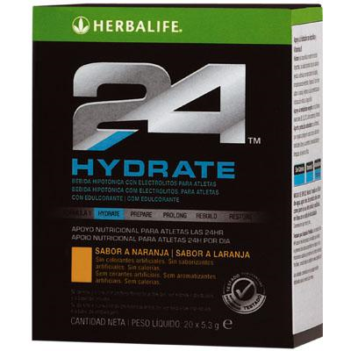
Hydrate
Only 15 Calories!
1 G Sugar
No Caffeine
Bioavailable Electrolytes (easily absorbed)
Vitamins:
C- Protein formation & healthy tissue & cells
B1- Metabolize carbs
B6 - Breakdown protein
B12- CNS function, energy

Slide 18
Rebuild
Strength
Endurance

Slide 19
Rebuild
Strength
Endurance
24g Whey & Casein Protein
4000mg BCAA
3000mg L-Glutamine
18g Carbs- Utilizes protein/ store glycogen
*Both have BCAA’s, Vit C, B1, 6 & 12
27g Carbs- replenish glycogen
10g Whey & Casein Protein
2000g L-Glutamine & BCAA
1000mg L-Carnitine- metabolism of fat into the mitochodria

Slide 20
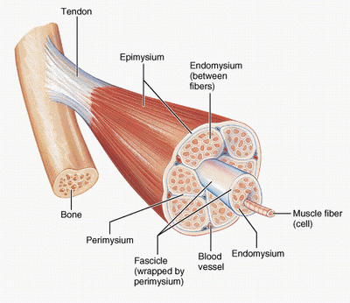
Protein
Not just for bodybuilders
Important for every cell
Building blocks:
Hormones
Enzymes
Neurotransmitters
Immune system
Build & repair muscle

Slide 21
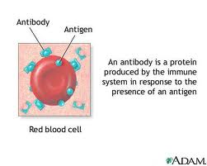
Protein
Creates RBC
Keeps hair, skin & nails healthy
Produces antibodies

Slide 22
Protein
Eat more protein!!!
Maintain/ increase muscle mass
Increase metabolism
Stay in anabolic state
Feel more full
Lose weight

Slide 23
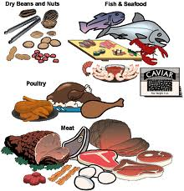
Protein
1.4- 2.0 grams per kilogram bw
Soy protein is the healthiest
Less saturated fats
Less cholesterol
Lowers LDL
Increases HDL
Other good sources:
Lean meats
Poultry
Nuts
Beans
Fish

Slide 24
Program for wrestlers
Healthy Meal Replacement Smoothie
Choose from 7 different delicious flavors
Protein Drink Mix
Chocolate or vanilla
Herbal Tea
Original, lemon, peach ,raspberry
Aloe Drink - hydration and electrolytes, digestive aid
Herbalife 24 Hydrate - hydration, electrolytes
2/day – morning & after practice

Slide 25
Meal Plans
 | Shakes | Meals
Lose Weight | 2-3 x Day | 1-2 x Day
Gain Weight | 3+ x Day | 3+ x Day
Maintain Weight | 1-2 x Day | 2-3 x Day

Slide 26
Price Breakdown
Retail 25% Off Cost Per/Meal
Healthy Meal Replacement: 41.65 32.79
Protein drink mix 51.11 40.24
Cost / Month 92.76 73.30 $2.43
Aloe 31.73 24.98 $3.26
Herbal Tea 25.38 19.98 $3.10
Cost / Month 149.87 117.99 $3.93
Add 24 Hydrate +35.19 +27.70
Add Rebuild Strength +86.89 +68.89
or
Add Rebuild Endurance +70.44 +55.45
One Month Supply Ryan Weisenbacher- cell 330-283-4481
email- ryan@ryantraining.com
Office 330-334-3820

